Slide 2
Are you interested in being a part of the 2025-2026 swim and dive team? Join us for an information meeting after school Thursday July 17th in Ms. Thompson's classroom. We will be hosting a Swim and Dive camp from July 28th through August 8th with tryouts beginning on August 11th. Please follow us on Instagram and Facebook at Basha Swim and Dive for more information over the summer.

Slide 4
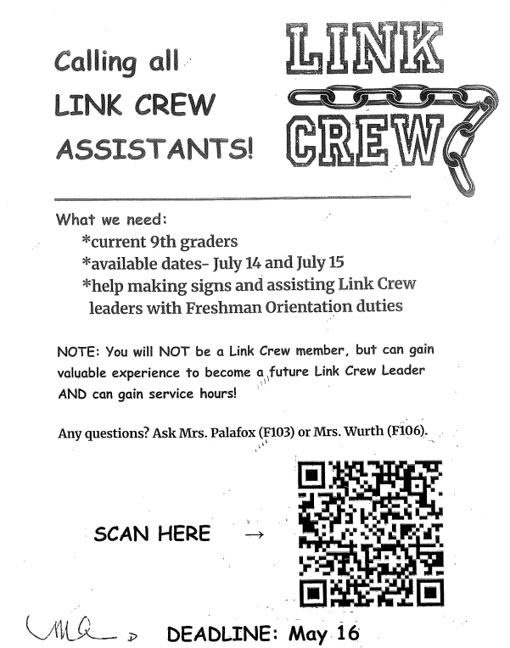

Slide 5
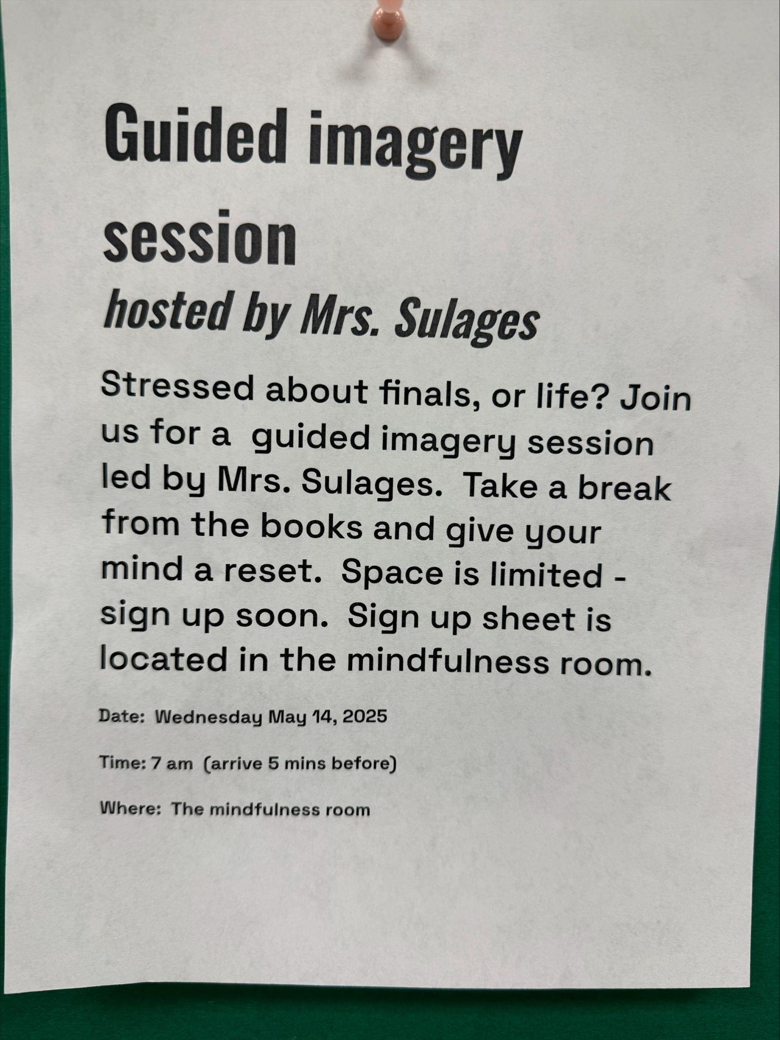

Slide 13
BASHA HIGH
does not accept food deliveries or food drop offs.
Thank you!

Slide 14
Basha High dress code.
Brief and revealing clothing, clothing with messages that are vulgar, offensive, obscene, or demeaning to others are not appropriate apparel.
Students wearing such items will be dress coded. If you have questions about the dress code, please refer to BHS Handbook.

Slide 15
New Library rules for the new year!
No FOOD or DRINK.
No rough play.
No inappropriate language.
Water is acceptable.
Please keep the library clean.
Stay awesome and respect the space!

Slide 16
Your unwanted glasses will help someone see better!
Donate Today! Box is at Hannah’s desk in the front office.

